Slide 1
Integrating Start-Ups Into Your Research Franchise
Steve Haggerty
Interior Lines Advisory
November 2024
CONFIDENTIAL

Slide 2
Integrating Start-Ups Into Your Research Franchise Agenda
Some Definitions
The Increasing Importance of Start-Ups and Private Companies for the Sellside and Buyside
How Start-Ups Can Enhance Your Equity Franchise
Navigating the Start-Up Landscape
What Can Research Analysts Do?
Some Real-World Examples
Wrap-up

Slide 3
Integrating Start-Ups Into Your Research Franchise
Some Definitions for This Discussion
Private Companies | Private companies are businesses owned by private individuals, families, or a small group of investors and not publicly traded on a stock exchange. Well-known examples include Cargill, Koch Industries, and Mars Inc.
Private Equity | Private equity (PE) is a form of investment capital raised from institutional and individual investors to invest in private companies, often with the goal of improving their performance and increasing their value. PE investments are often aimed at mature companies, with firms using various strategies such as leveraged buyouts.
Start-ups | Start-ups are businesses that are in the initial phases of development. They usually have a business concept or prototype but may not yet have a full product, established revenue, or profitability. These companies are often focused on innovation and high growth potential, which makes them attractive for venture capital and angel investors willing to take on high risk for the possibility of substantial returns.

Slide 4
Integrating Start-Ups Into Your Research Franchise The Increasing Importance of Start-Ups and Privates for the Sellside and Buyside
Institutional Equity Firms
Mutual Funds 7,222
Hedge Funds 3,872
Mkt Cap $55,000bns
Type
Endowments
Family Offices
HNWIs
Insurance Companies
Pension Funds
Retail Investors
Venture Capital Funds
Funds 3,417
AUM $1,212bns
Type
Endowments
Cross Over Funds
Family Offices
HNWIs
Mutual Funds
Pension Funds
Private Equity Firms
Firms 4,500
AUM $6,300bns
Type
Endowments
Family Offices
HNWIs
Insurance Companies
Mutual Funds
Hedge Funds
Pension Funds
Retail Investors
Source: NVCA – Pitchbook, Fintech Futures & Modor Intelligence, EY, IBISWORLD, Statista, Financial Times, U.S. Data

Slide 5
Integrating Start-Ups Into Your Research Franchise The Increasing Importance of Start-ups and Privates for Sellside and Buyside firms
More Institutional Capital
More Institutional Research
Institutional Equity Firms
Mutual Funds 7,222
Hedge Funds 3,872
Mkt Cap $55,000bns
Type
Endowments
Family Offices
HNWIs
Insurance Companies
Pension Funds
Retail Investors
Venture Capital Funds
Funds 3,417
AUM $1,212bns
Type
Endowments
Cross Over Funds
Family Offices
HNWIs
Mutual Funds
Pension Funds
Retail Investors
Private Equity Firms
Firms 4,500
AUM $6,300bns
Type
Endowments
Family Offices
HNWIs
Insurance Companies
Mutual Funds
Hedge Funds
Pension Funds
Retail Investors
Source: NVCA – Pitchbook, Fintech Futures & Modor Intelligence, EY, IBISWORLD

Slide 6
Integrating Start-Ups Into Your Research Franchise The Increasing Importance of Start-Ups and Private Companies for the Sellside and Buyside
The value of Privates (Start-ups and Private Companies) is increasing, Private Companies, especially Start-ups are staying private longer and the differences between Public and Private assets are blurring (especially in Credit)
Institutional capital is looking for new sources of Alpha as long-term Public market returns are expected to be lower than historical returns
Many Buyside firms are increasing the structure and size of in-house Start-Up investment teams and value the insight that Sellside firms can provide on those businesses
Some Sellside firms are beginning to adapt their Research content to provide Start-Up analysis to Buyside firms

Slide 7
Integrating Start-Ups Into Your Research Franchise How Start-Ups Can Enhance Your Research Franchise
Aligns your franchise with the growing Buyside interest in Start-Ups and Private Companies
Helps you identify potential disruptive trends in your sector
Offers opportunities for additional Research content and Touchpoints (Client Calls, Conferences, Industry notes)
Exposes you to a new group of investors – Venture Capitalists
Makes you look smarter to Clients, Corporates, Business Partners (Sales, Banking)
YOU WILL SEE THIS CHART AGAIN

Slide 8
Integrating Start-Ups Into Your Research Franchise Navigating the Start-up Landscape The value of Privates (Start-ups and Private Companies) is increasing, and Private Companies, especially Start-ups are staying Private longer
From 2010 to 2022 the number of Private Companies valued over $1.0bn increased from 50 to 1,200
Source: Cambridge Associate, Jay Ritter, Russell, University of Florida, World Federation of Exchanges, J.P. Morgan Asset Management, UBS

Slide 9
Integrating Start-Ups Into Your Research Franchise Navigating the Start-up Landscape
Asset managers are looking for Alpha outside Public markets
Source: Pitchbook Goldman Sachs

Slide 10
Integrating Start-Ups Into Your Research Franchise Navigating the Start-up Landscape
Venture and Private returns have outpaced Institutional Equity returns
Asset Class Comparison 2023 Long-term Returns
Venture Capital Funds (Start-ups) | Private Equity Funds | Institutional Equity Funds
10 Year Annualized Return 15.33%^ | 10 Year Annualized Return 15.59%^ | U.S. Large Cap Mutual Fund 10 Year Annualized Return 12.5%# Hedge Funds 10 Year Annualized Return 5.6%* S&P 10 Year Annualized returns 12.69%@
^Cambridge Associates 10 years ended Dec 2023
#Morningstar – 10 years ended Dec 2023
*HFRI Equity Total Index – 10 years ended June 2024
@ Ajo Vista –10 Years ended May 2024

Slide 11
Integrating Start-Ups Into Your Research Franchise Navigating the Start-up Landscape
Several Buyside firms are changing fund structures and increasing the size of their early-stage investment teams

Slide 12
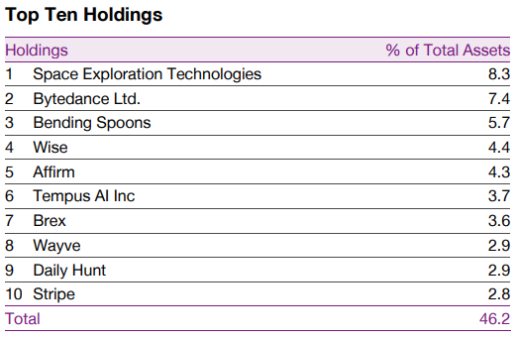
Integrating Start-Ups Into Your Research Franchise Navigating the Start-up Landscape
The Schiehallion Fund Limited (Trust Fund, $1,222m Total Assets) seeks to generate capital growth for investors through long-term minority investments in later stage private businesses that the Company considers to have transformational growth potential and to have the potential to become publicly traded.
Baillie Gifford’s launched a new fund – Private Companies Fund III – in 2023 to attract institutional capital
Source: Baillie Gifford, data as of September 30, 2024

Slide 13
Integrating Start-Ups Into Your Research Franchise Navigating the Start-up Landscape – New entrants
CAPITAL NEWS
Fidelity Raised Its First VC Fund
Fidelity Investments has raised $250 million for its first-ever venture capital fund.
October 4, 2024
The giant manager has been an investor in growth-stage companies for many years,
For more than 15 years, Fidelity, which has $5.5 trillion in discretionary assets, has been investing in growth-stage companies through some of its mutual funds.
But it was time for a dedicated venture fund. The reason is that more companies are staying private longer. Fidelity and other investors have fewer public ones to choose from, with less upside to capture, so they want to become shareholders before an IPO.
Source: Institutional Investor

Slide 14
Integrating Start-Ups Into Your Research Franchise Navigating the Start-Up Landscape – Start-Ups offer new products and services
The term Start-Up refers to a company in the first non-public stages of business operations.
Start-Ups are typically created by one or more Founders who want to develop a product or service for which they believe there is new or unrecognized demand.
The framework of “what problem are you trying to solve” is often used as a lens for understanding the reason for the new business.
These companies generally start with high costs and zero revenue and look for capital from a variety of sources including: Friends & Family, Investment Clubs, Family Offices, Foundations, Venture Capital Funds and increasingly Institutional Equity.

Slide 15
Integrating Start-Ups Into Your Research Franchise Navigating the Start-Up Landscape – Start-Ups and Venture Capital Funds
Venture Capital Funds (VCs) are a source of Early-Stage financing or "venture capital" for start-ups, often in high-tech or emerging industries.
VCs manage pooled investments in high-growth startups, early-stage and growth stage firms.
Investors in VCs have a long investment horizon – 5 to 10 years.
Investors in VCs earn a return when a portfolio company exits, either through an IPO, merger, or strategic acquisition.
This presentation uses VC Fund (NVCA) data to look at the Start-up landscape data.

Slide 16
Integrating Start-Ups Into Your Research Franchise Navigating the Start-Up Landscape – There is a National Venture Capital Association (NVCA)

Slide 17
Integrating Start-ups Into Your Research Franchise Navigating the Start-Up Landscape – Start-Ups and Venture Capital Are Not New
1946 – Georges F. Doriot “the father of venture capital”, formed the first modern Venture Capital (VC) firm called the American Research and Development Corporation (ARDC).
1950s – Arthur Rock, a student of Doriot’s helped secure funding for “The Traitorous Eight” who formed Fairchild Semiconductor in 1957. Among the eight were: Eugen Kleiner, Gordon Moore and Robert Noyce.
1972 – Sequoia Capital was founded by Don Valentine, a salesman from Fairchild Semiconductor. Kleiner Perkins was also founded.
1979 – Changes to the Employee Retirement Income Security Act’s (ERISA) “Prudent Man Rule” made it easier for corporate pension funds to invest in Venture Capital funds.
1990s – The rise in personal computers and the internet led to a technology venture boom. With companies like Netscape, Amazon, eBay, Netflix, PayPal, Yahoo, Google, and Salesforce coming to the market with Venture Capital backing.

Slide 18
Integrating Start-Ups Into Your Research Franchise Navigating the Start-Up Landscape – Four Key Start-Up Funding Stages
PROGRESSION
Funding Stage | Profile
Pre-Seed: This is the earliest stage of business development when the founders demonstrate the concept, build product prototypes, and validate the Total Addressable Market (TAM). Angel/Seed Funding: This is the point where a new business seeks to launch its first product, attract customers and assess scalability. Typically, there is no revenue. | Disruptors Acquisition
Early/Later – Stage Funding: An emerging business will seek to ramp up production and sales to scale the business, generate revenue and move toward profitability and positive cash flow. The business will use funding rounds denoted as Series A, Series B, maybe Series C, etc. as it moves toward a strategic investor or IPO. Growth-Stage Funding: Based on age of company, prior financing history and participating investors. Typically classified as Series D or later and often with revenue and profit. | Buyout IPO
Source: Investopedia/Notion Capital

Slide 19
Integrating Start-Ups Into Your Research Franchise Navigating the Start-Up Landscape – Venture Activity Fell Dramatically in 2022 & 2023
Source: Pitchbook

Slide 20
Integrating Start-Ups Into Your Research Franchise Navigating the Start-Up Landscape – AUM Grew Rapidly then Peaked in 2022
Source: Pitchbook

Slide 21
Integrating Start-Ups Into Your Research Franchise Navigating the Start-Up Landscape – Not Just Software and Biotech
*Other includes Agriculture, Commercial Products, Commercial Transportation, Utilities, Insurance, Consumer Durables, Consumer Nondurables, Chemicals and Gases, etc.
Source: Pitchbook

Slide 22
Integrating Start-Ups Into Your Research Franchise Navigating the Start-up Landscape – Different Players
Source: Pitchbook

Slide 23
Integrating Start-Ups Into Your Research Franchise Navigating the Start-Up Landscape – Public Listings Are a Small Percentage of Total Exits
Start-Up Exits 2023
Source: Pitchbook-NVCA Venture Monitor, as of December 31, 2023

Slide 24
Integrating Start-Ups Into Your Research Franchise What Can Research Analysts Do?
Start-Ups are not just Tech – there are most likely companies in your sector (Although every startup will now utilize the term AI)
Attend Start-Up and Venture Capital conferences in your sector (there are lots in NYC)
Meet Start-Ups at these events
Profile interesting start-Ups in research reports along side public companies
Utilize Start-Ups in:
Your corporate access events alongside public companies
Webinars with founders or experts on emerging sector technologies
Provide feedback on these emerging firms and technologies to your Buyside clients

Slide 25
Integrating Start-Ups Into Your Research Franchise What Can Research Analysts Do? Resources: Start-Up websites
VCs by Stage | VCs by Location | VCs by industry | Angel Investors
⬪ Pre-Seed: https://lnkd.in/gnxYgFF8 ⬪ 750+ Seed Funds: https://lnkd.in/g7rntFQa ⬪ NYC Early Stage: https://lnkd.in/gMKTstBz ⬪ Seed & Series A: https://lnkd.in/gU_PZwra ⬪ Below 200 Million: https://lnkd.in/g4QhNsjV | ⬪ Most Active US: https://lnkd.in/gDcKfxwD ⬪ NYC: https://lnkd.in/gMKTstBz ⬪ European VCs: https://lnkd.in/gZC4qqxW ⬪ UK VCs: https://lnkd.in/gkPYUKH3 ⬪ French VCs: https://lnkd.in/g2bHpUYd ⬪ Spanish VCs: https://lnkd.in/gBD_7rRY ⬪ Baltic VCs: https://lnkd.in/gx2iHdDS ⬪ Australian VCs: https://lnkd.in/gbFnpmRX ⬪ Indian VCs: https://lnkd.in/durcuiUw ⬪ Singapore VCs: https://mapofthemoney.com/ | ⬪ Climate VCs: https://lnkd.in/d__3NqRC ⬪ Deep Tech VCs: https://lnkd.in/gqTqjKJu ⬪ HealthTech VCs: https://lnkd.in/gMWDprYC ⬪ Consumer VCs: https://lnkd.in/ganPEBgV ⬪ FinTech VCs: https://lnkd.in/gWFADRuP | ⬪ US Founders Investing: https://lnkd.in/gHtZZY2y ⬪ SaaS Angels: https://lnkd.in/g3z9sBAE ⬪ US Women: https://lnkd.in/gd4JefpG ⬪ Global Women: https://lnkd.in/gYAW3avh ⬪ Crypto: https://lnkd.in/gJfuaFVy ⬪ Australia: https://lnkd.in/gxYmwaTb ⬪ Africa: https://lnkd.in/g3z-cx6z ⬪ Middle East: https://lnkd.in/ghZ5PeQF
Source: https://www.eu.vc/p/the-best-investor-databases-and-lists

Slide 26
Integrating Start-Ups Into Your Research Franchise What Can Research Analysts Do? Resources: Start-Up Ag Tech Conferences (Examples)
Source: reThink

Slide 27
Integrating Start-Ups Into Your Research Franchise What Can Research Analysts Do? Resources: Pitchbook
Source: Pitchbook

Slide 28
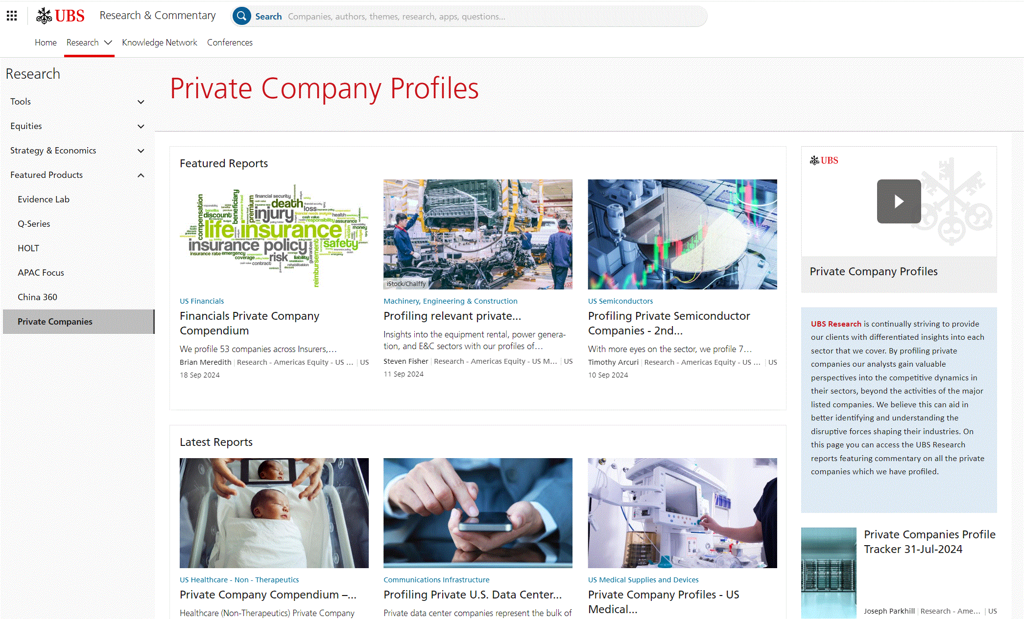
Integrating Start-ups Into Your Research Franchise Some Real World Examples– Sellside Research is beginning to adapt its product suite
Source: UBS

Slide 29
Integrating Start-ups Into Your Research Franchise Some Real World Examples– Sellside Research is beginning to adapt its product suite
Source: UBS

Slide 30
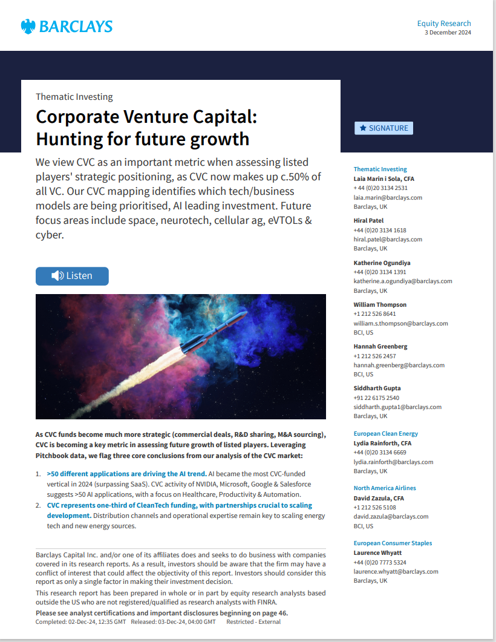
Integrating Start-ups Into Your Research Franchise Some Real World Examples– Sellside Research is beginning to adapt its product suite
Source: UBS

Slide 31
Integrating Start-Ups Into Your Research Franchise Some Real-World Examples – Start-Ups in Corporate Access Trips

Slide 32
Integrating Start-Ups Into Your Research Franchise Wrap-Up…… How Start-ups Can Enhance Your Research Franchise
Aligns your franchise with the growing Buyside interest in Start-Ups and Private companies
Helps you identify potential disruptive trends in your sector
Offers opportunities for additional Research content and Touchpoints (Client Calls, Conferences, Industry notes)
Exposes you to a new group of investors – Venture Capitalists
Makes you look smarter to clients, corporates, business partners (Sales, Banking)
THIS IS THE REPEAT SLIDE

Slide 33
Integrating Start-Ups Into Your Research Franchise
Wrap-Up/Q&A

Slide 34
Integrating Start-Ups Into Your Research Franchise
Appendix

